Slide 1


The Fine Tuners
07.11.2023

Slide 2

Table of Content
Introduction
01
02
Data Understanding
Data Structure
Annotations
Data Volume
Distributions
Data Representativeness
Data Limitations
Data Preparation
03
Handling Missing Values
Identifying and Removing Outliers
04
Summary
Next Steps
05

Slide 3

Introduction
Purpose:
Importance of Data Understanding and Data Preparation

Slide 4




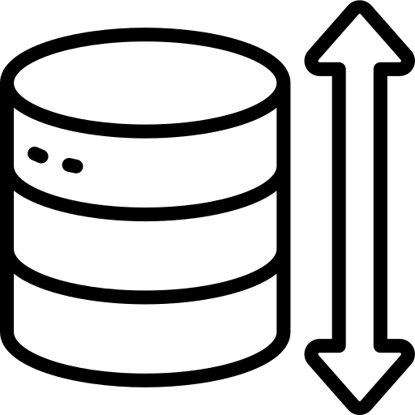


Data Understanding Data Structure
Data Sources
Data Format
2 different sources
JSON File
Data Quality
Data Size
2219 Duplicates
3 columns have missing values
16.949 Rows
20 Columns
Data
Data Types
1 Date/Time
4 Categorical
8 Numeric,
1 String
6 Constant
Data Organisation
Flat File

Slide 5
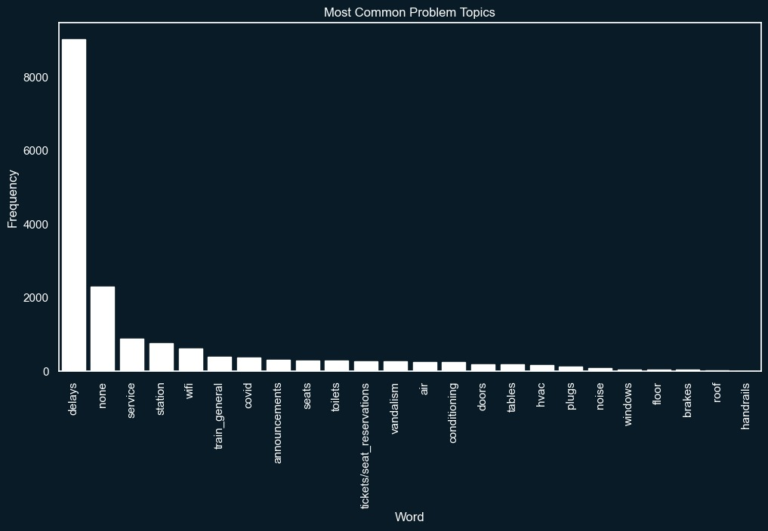
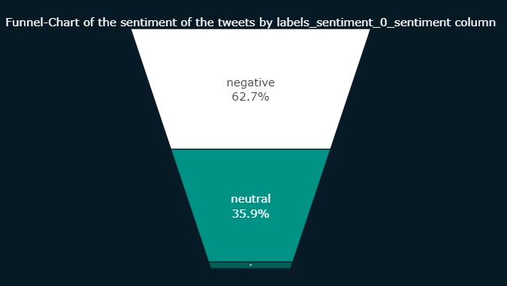
Data Understanding Annotations
The dataset includes categorical annotations for tweet topics, allowing us to classify and analyse tweets based on their respective subjects or themes.
The dataset includes sentiment annotations in the form of a 'Sentiment' column, categorising tweets into negative, positive, and neutral sentiments.
positive

Slide 6
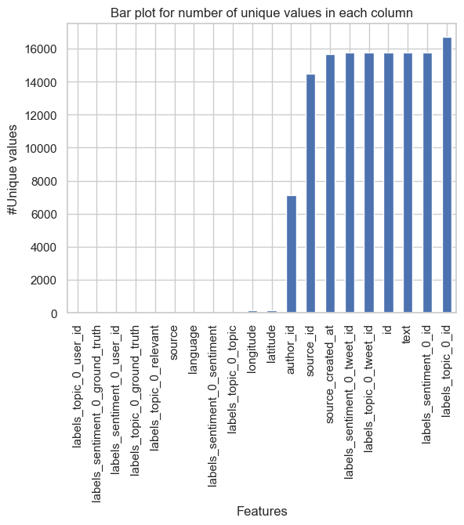
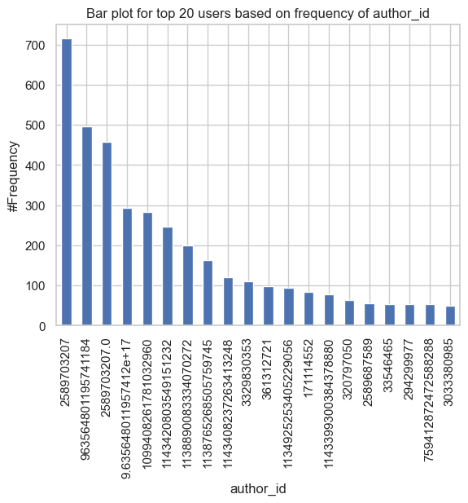
Data Understanding Data Volume
The dataset size of 16,949 tweets provides a substantial volume for the analysis.
The dataset contains 5+1 single-valued column with uniform
information across all rows.
Dataset exhibits diverse user interactions and content categorisations

Slide 7
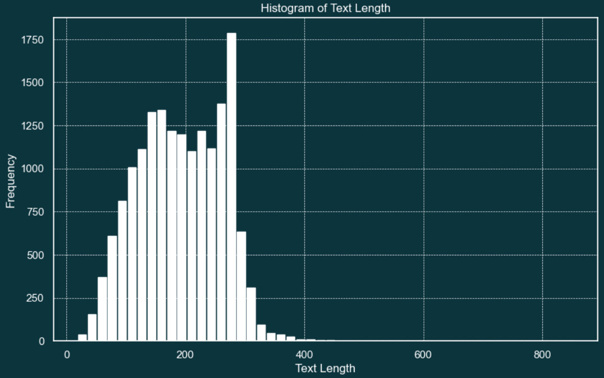
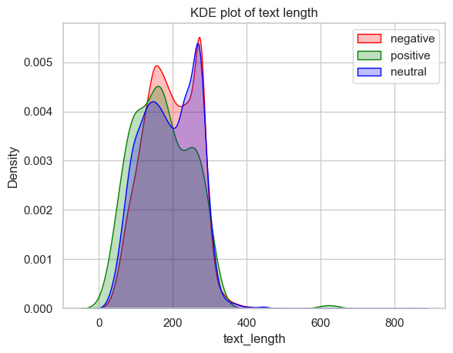
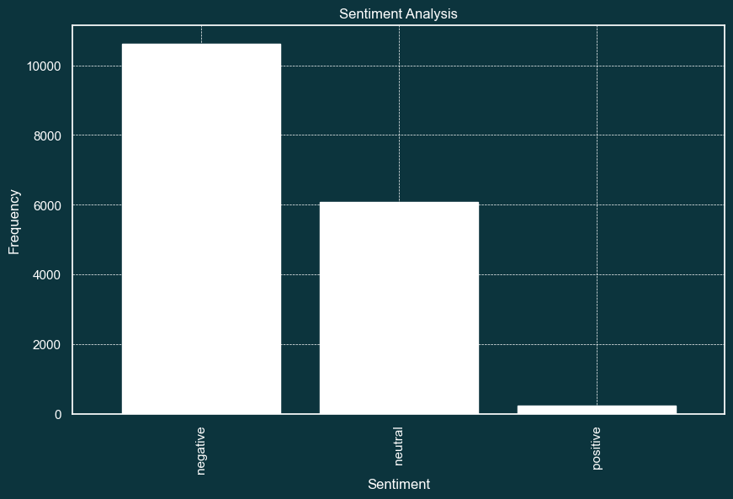
Data Understanding - Distributions
Length of tweets are controlled to tailor NLP models for accurate classification and recommendation tasks using social media data.
Analyzing sentiment in tweets allows to gauge customer sentiment towards Thameslink's maintenance services.
Customers are more likely to write longer tweets if the sentiment is negative

Slide 8

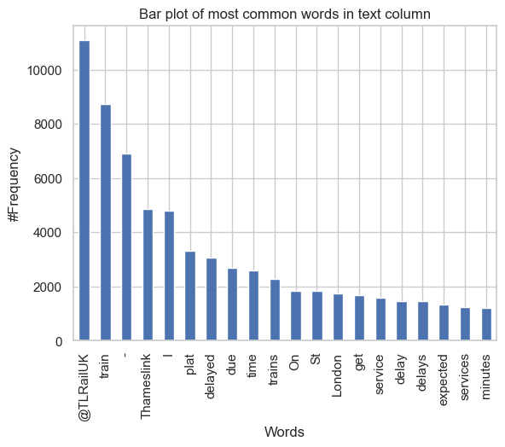
Data Understanding - Distributions
The most frequently used words were checked to ensure that unusual or unexpectedly frequently used words did not cause problems during data collection or preprocessing.

Slide 9
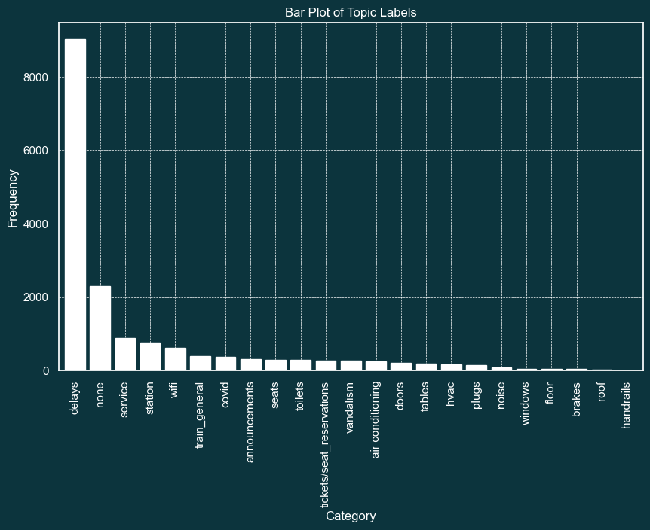
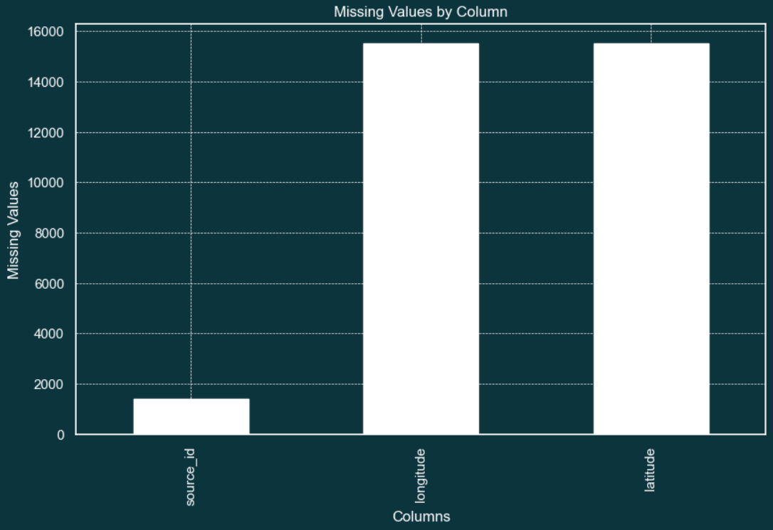
Data Understanding - Distributions
Topic column helps us to categorise problem by the tweet.
Longitude and Latitude columns are not able to be used, where we cannot gain any finding from GPS values.

Slide 10
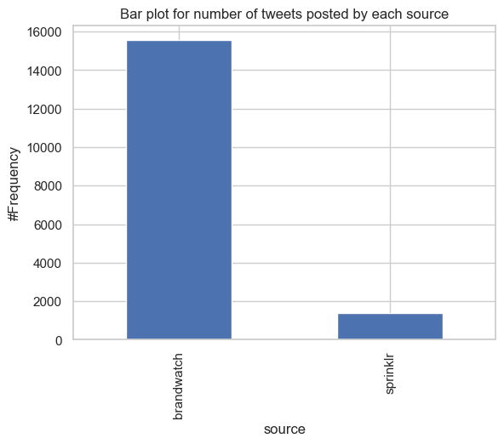
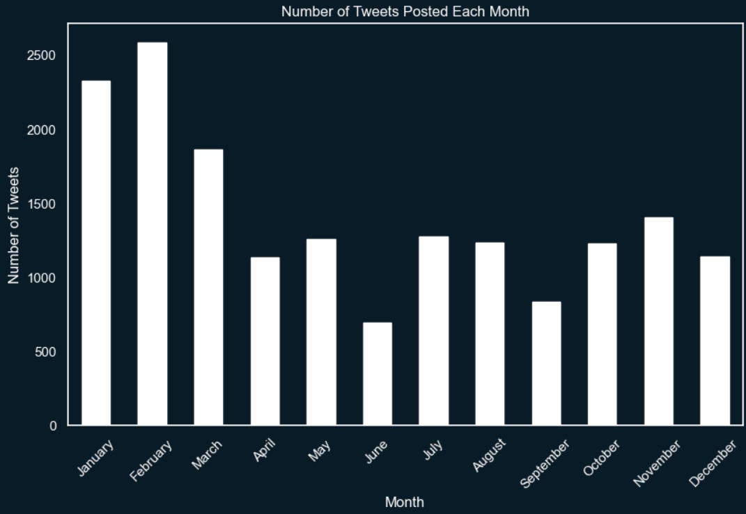
Data Understanding - Data Representativeness
The data is sourced from two distinct channels. The accompanying bar chart illustrates the distribution, highlighting the balance between the two sources in the dataset.
The bar chart illustrates that data collection occurred consistently across all twelve months of the year, ensuring a comprehensive representation of temporal patterns and minimizing potential seasonal biases.

Slide 11
Data Understanding - Data Representativeness
OUTLIERS IN THE DATA

Slide 12
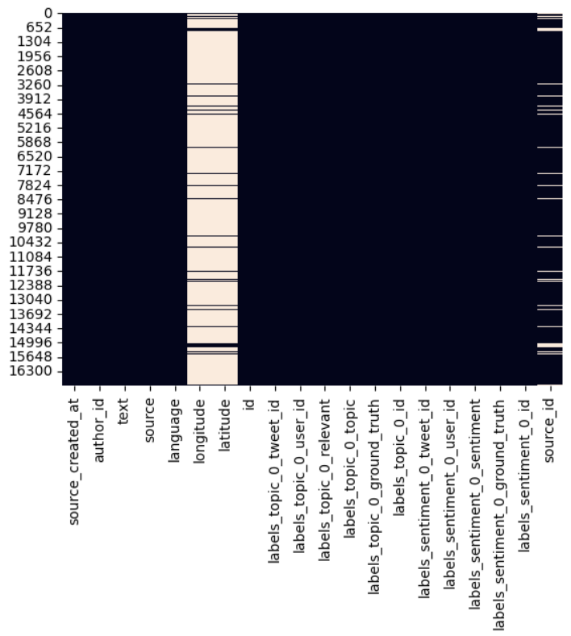
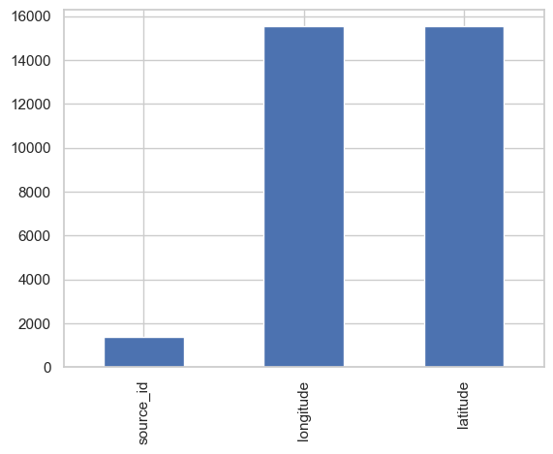
Data Understanding - Data Limitations
Three columns have missing values, and two are non-imputable
388 similar (90% - <100%)
rows
5+1 rows rows with a single value

Slide 13
Data Understanding - Data Limitations
Delays-related tweets lack actionable insights for maintenance improvements

Slide 14
Data Preparation
Handling Missing Values
Identifying and Removing Outliers

Slide 15
Thank you!

